Slide 1
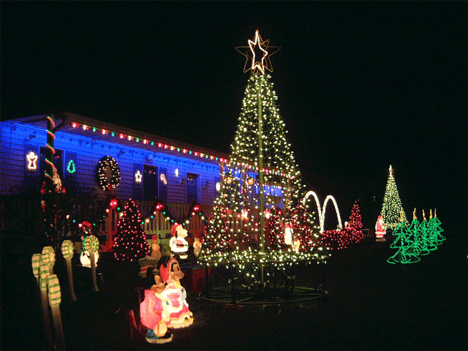
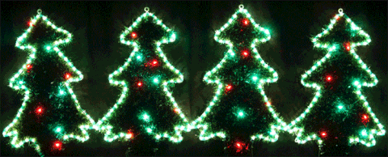
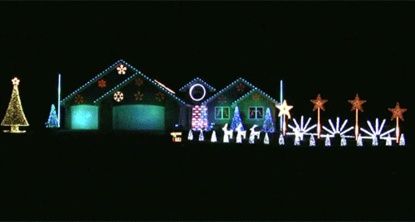
Sequence Lights Christmas Lights

Slide 2
Objectives
The project is expected to flash different color lights in two different modes and a static/on and off mode depending on the choice of the user.
This project utilizes state machines to control the light sequences.
An indicator LED was added on the FPGA as an indicator that the code is working therefore the parts that make up the project should work as well.
The purpose of this project is to understand how lights can be controlled by a case statement, a slowed down clock, and states in a state machine.
This project has many real world implications not just the lights at holiday time.

Slide 3
Materials
1 FPGA board
1 USB type A to Mini B 5-pin cable
1 laptop
1 breadboard
8 solderless wires
16 Solderless LEDs: 4 yellow, 4 green, 4 red, 4 white
3 push buttons

Slide 4
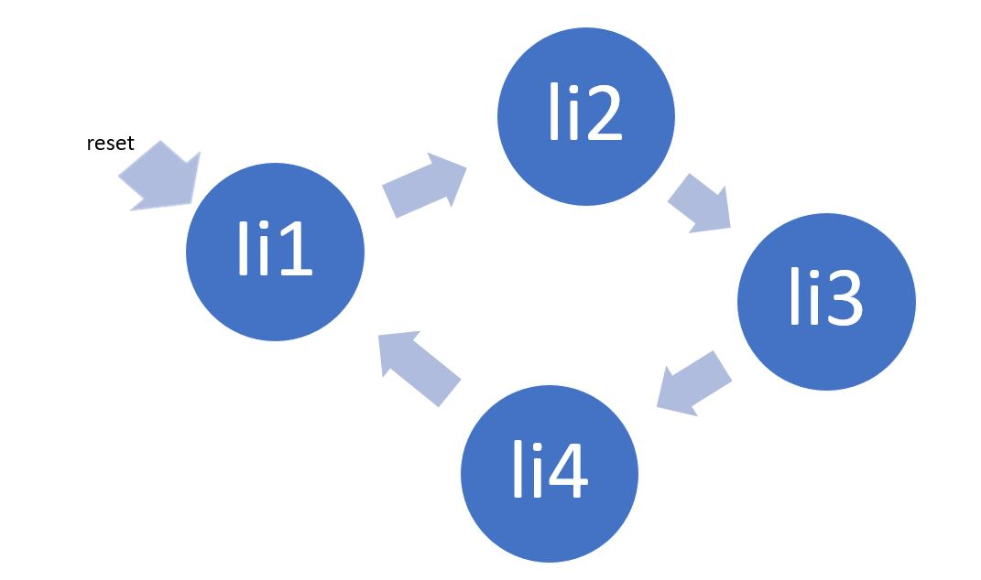
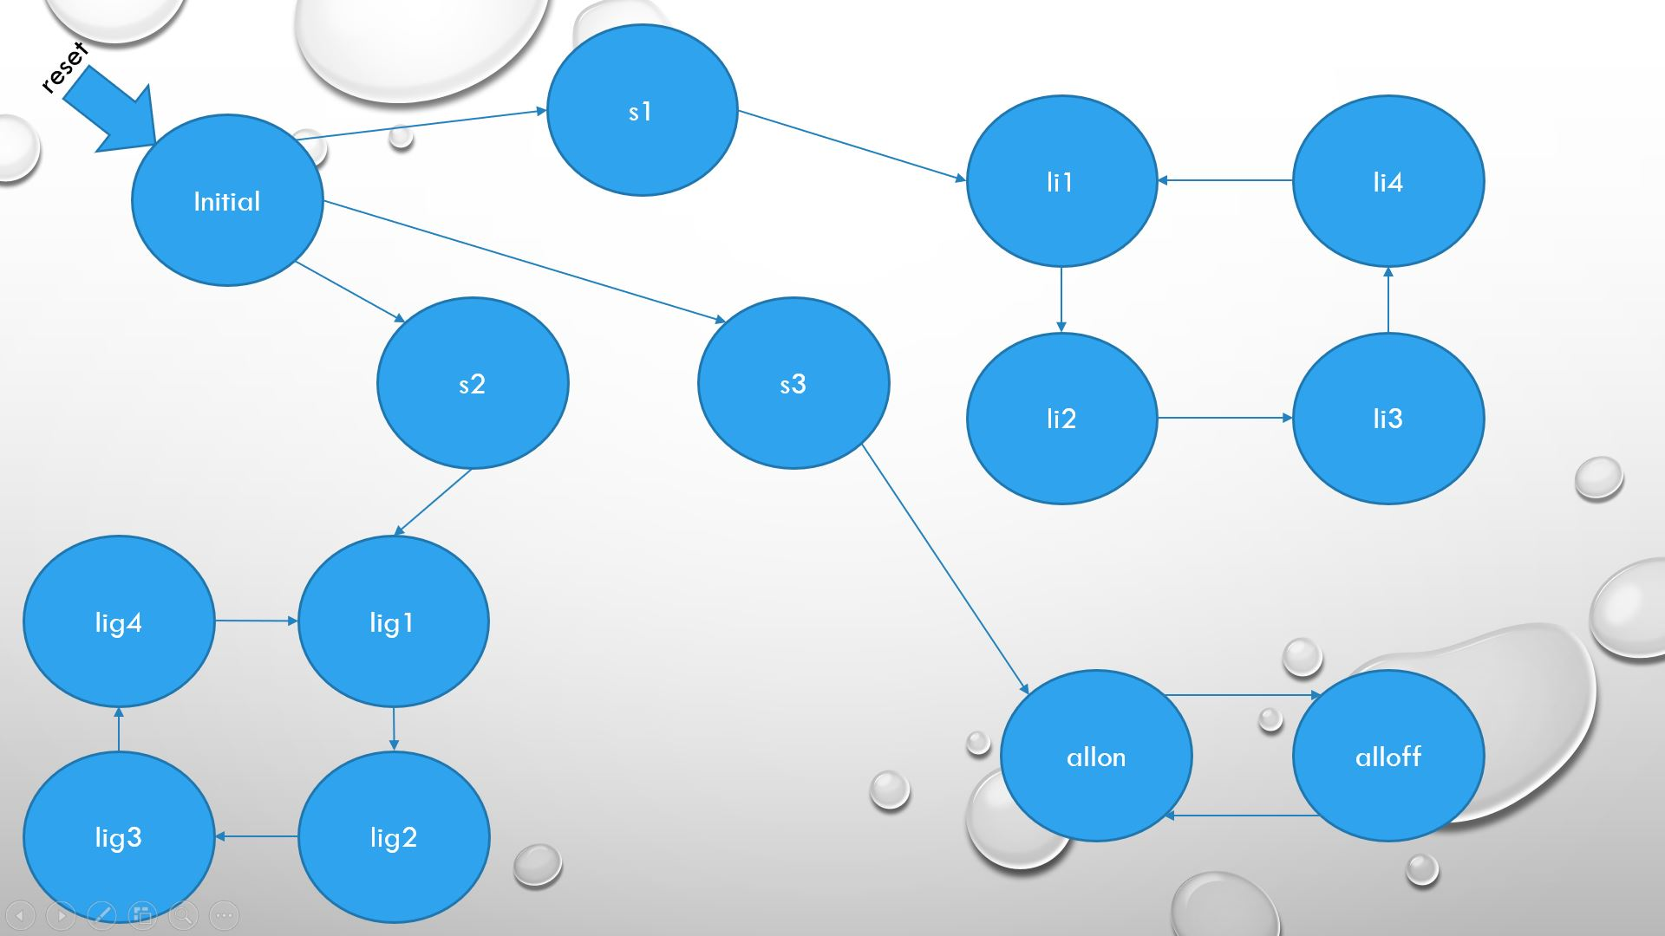
Thought process/prior state machines
Second More Complicated State Machine With Inputs and other sequences
Original Project Proposal State Machine

Slide 5
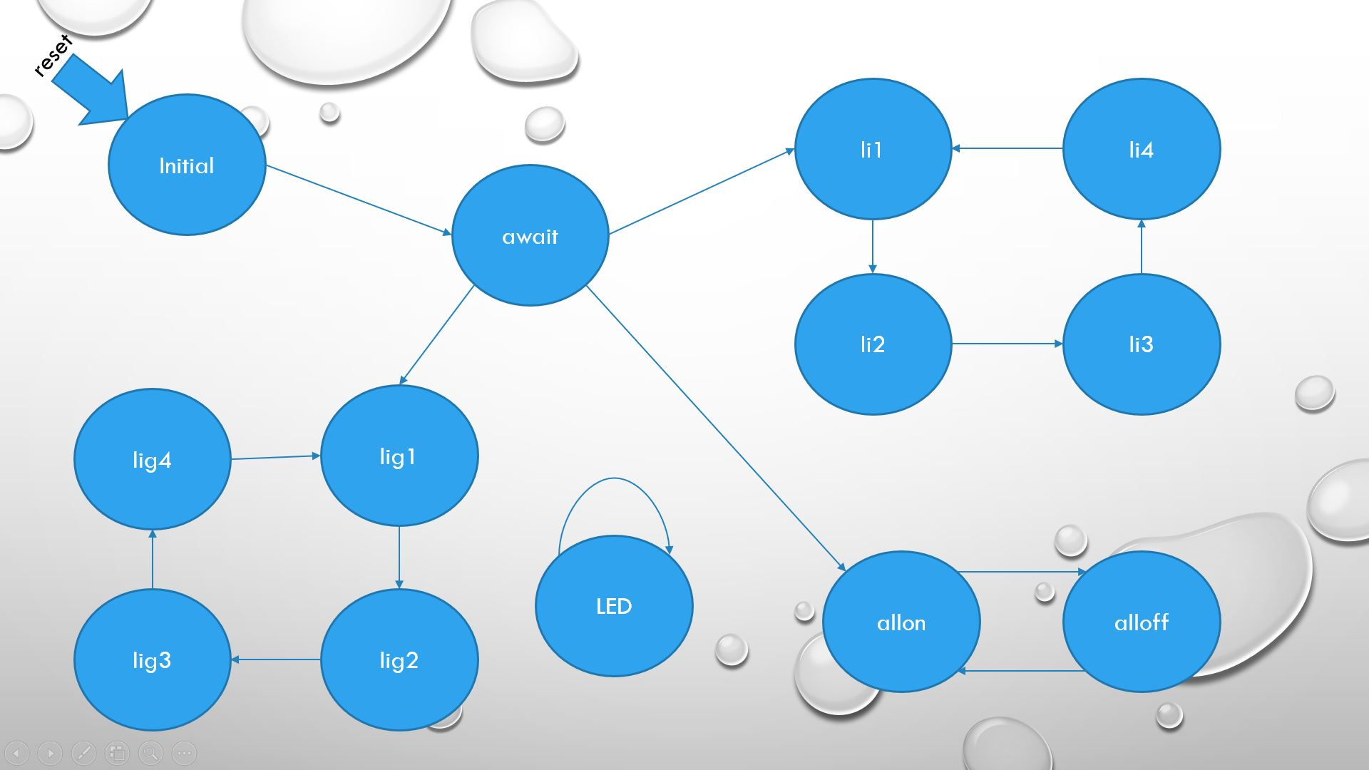
Final State Machine
State Machine with three sequences, user input, indicator LED, and one State Machine for input

Slide 6
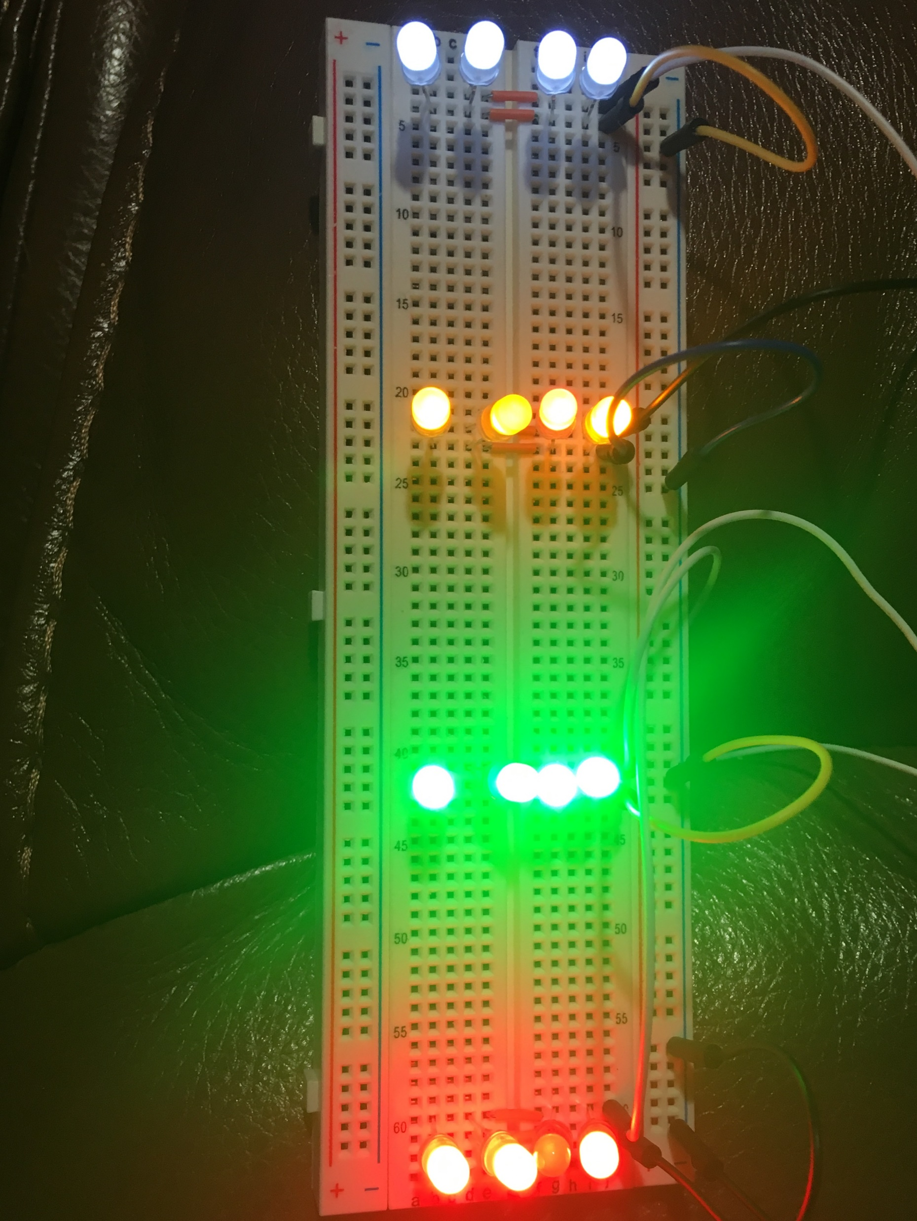
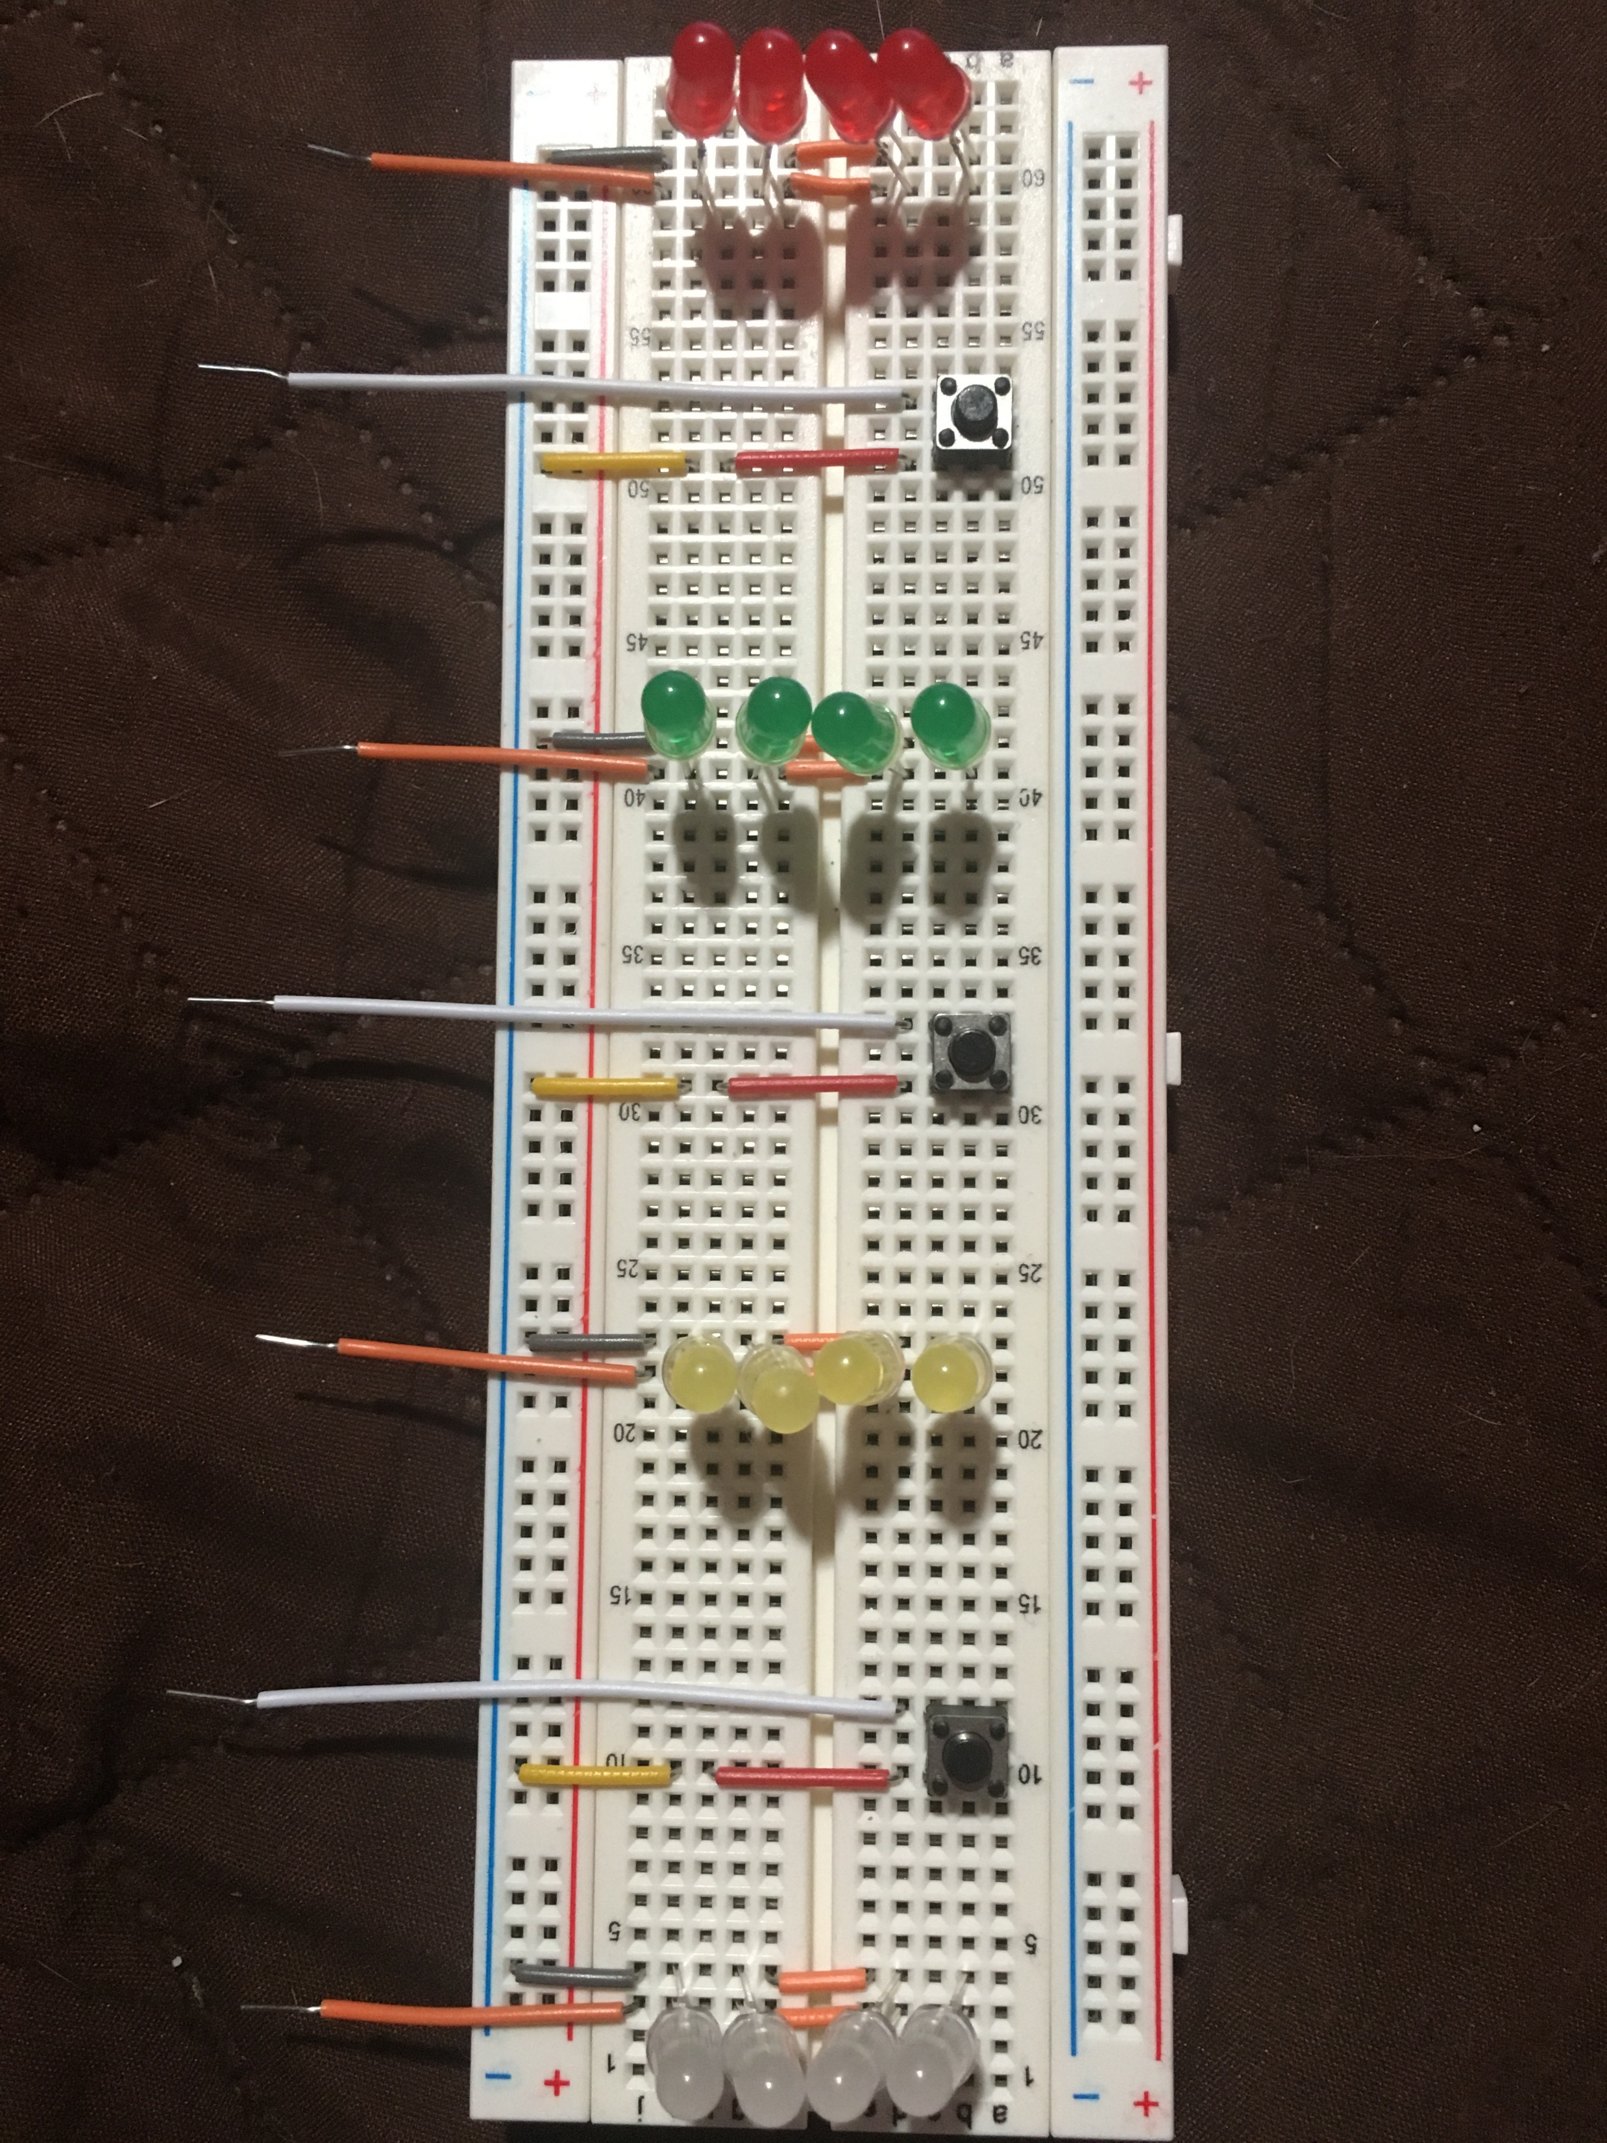
Original Design Vs. Final Design
Messy
No buttons for user input
LEDs do not blink or have sequence
Clean
Buttons for input
LEDs blink in three different modes

Slide 7
Troubleshooting
The first issue encountered was an issue with the clock. The code had to be adjusted to > 6000000 for a one second period.
The second issue was a delay from when the button is pressed to when the lights begin to flash. I resolved this by putting the push buttons on the breadboard rather than using the ones on the FPGA board then holding them down for a bit.
The third issue was adding more states with more push buttons would cause a large delay of ten seconds or more. Once I added the extra state the issue seemed to have stopped.
The fourth issue was incorrect mapping of the LEDs and push buttons to the FPGA board. I had connected everything to voltage and ground rather than the pins I had assigned them to which had kept them permanently on.
The last issue was cable management. I fixed this by using flat short cables in color coordination for the board and then long cables to reach the FPGA.

Slide 8
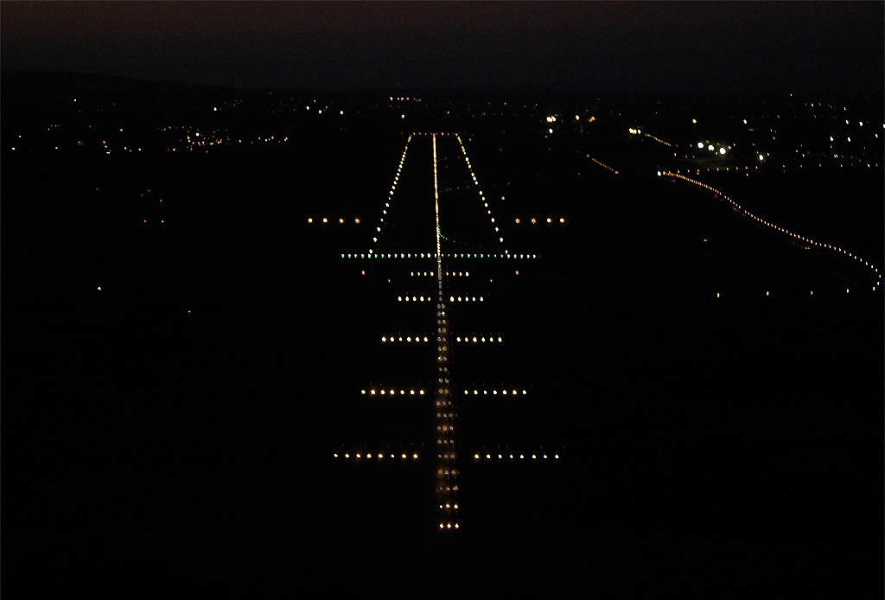
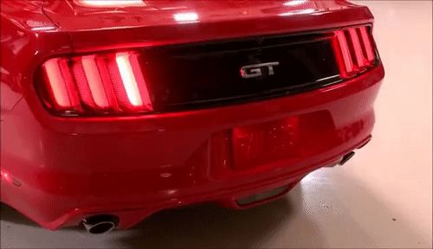
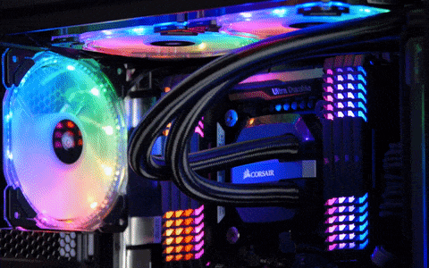

Real world application

Slide 9
Conclusions
The recommendations I would have for improvement are finding a way to put the buttons and the LEDs at different clock cycles to minimize the delay from pressing the button to the LEDs turning on on the breadboard.
Another modification is attempting to make the delay from pressing reset shorter since there is a big delay from pressing reset to the LEDs turning on.
A last modification would be modifying the actual way the lights flash or adding/taking away certain sequences to best fit the use.
I believe the project came out exactly as I expected it to work when I first thought of it. Some disadvantages are the delay and the limit of space on the breadboard for more LEDs or push buttons.

